Slide 1

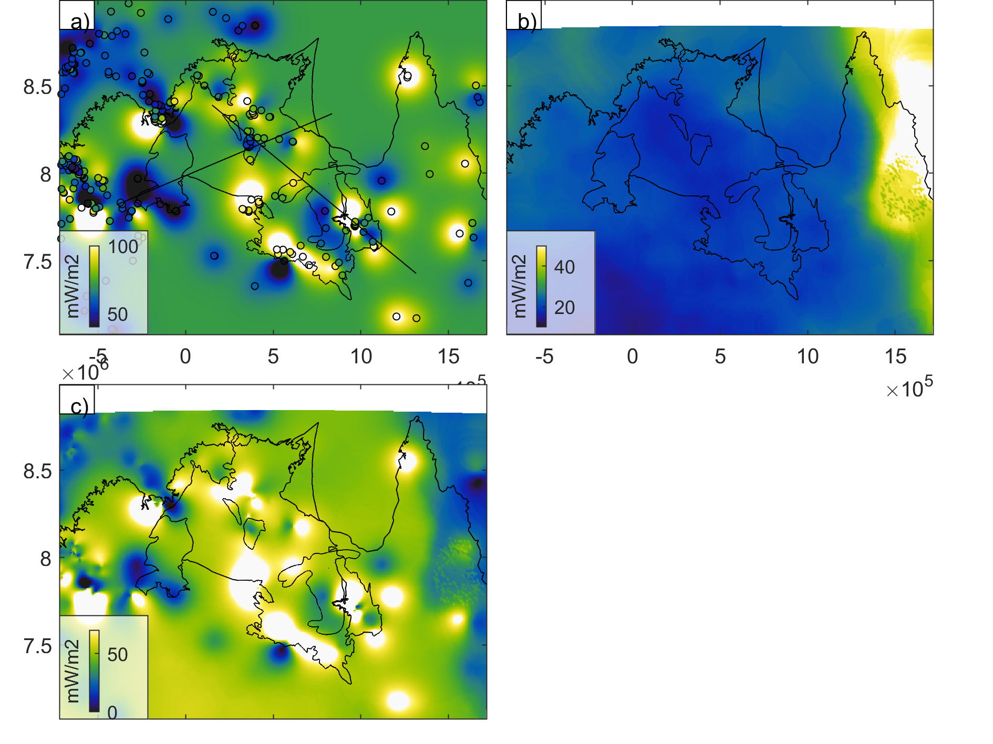
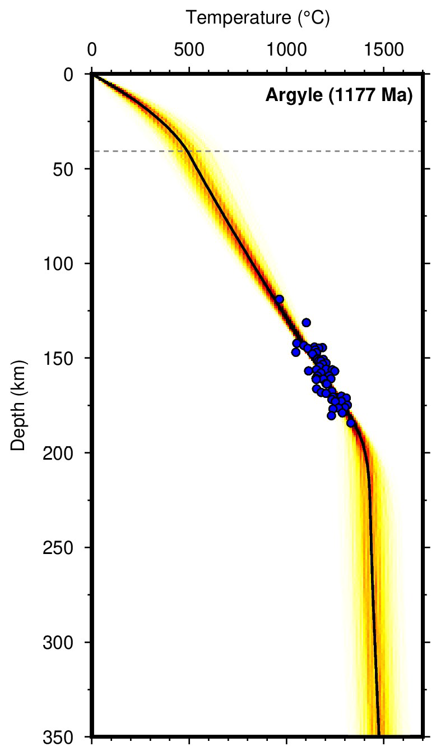
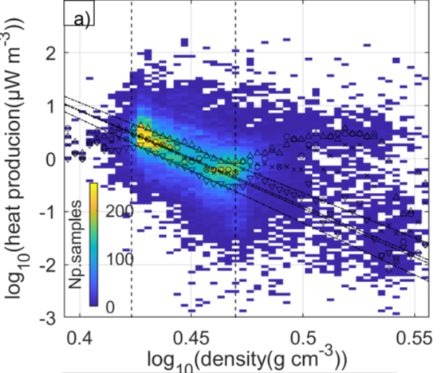
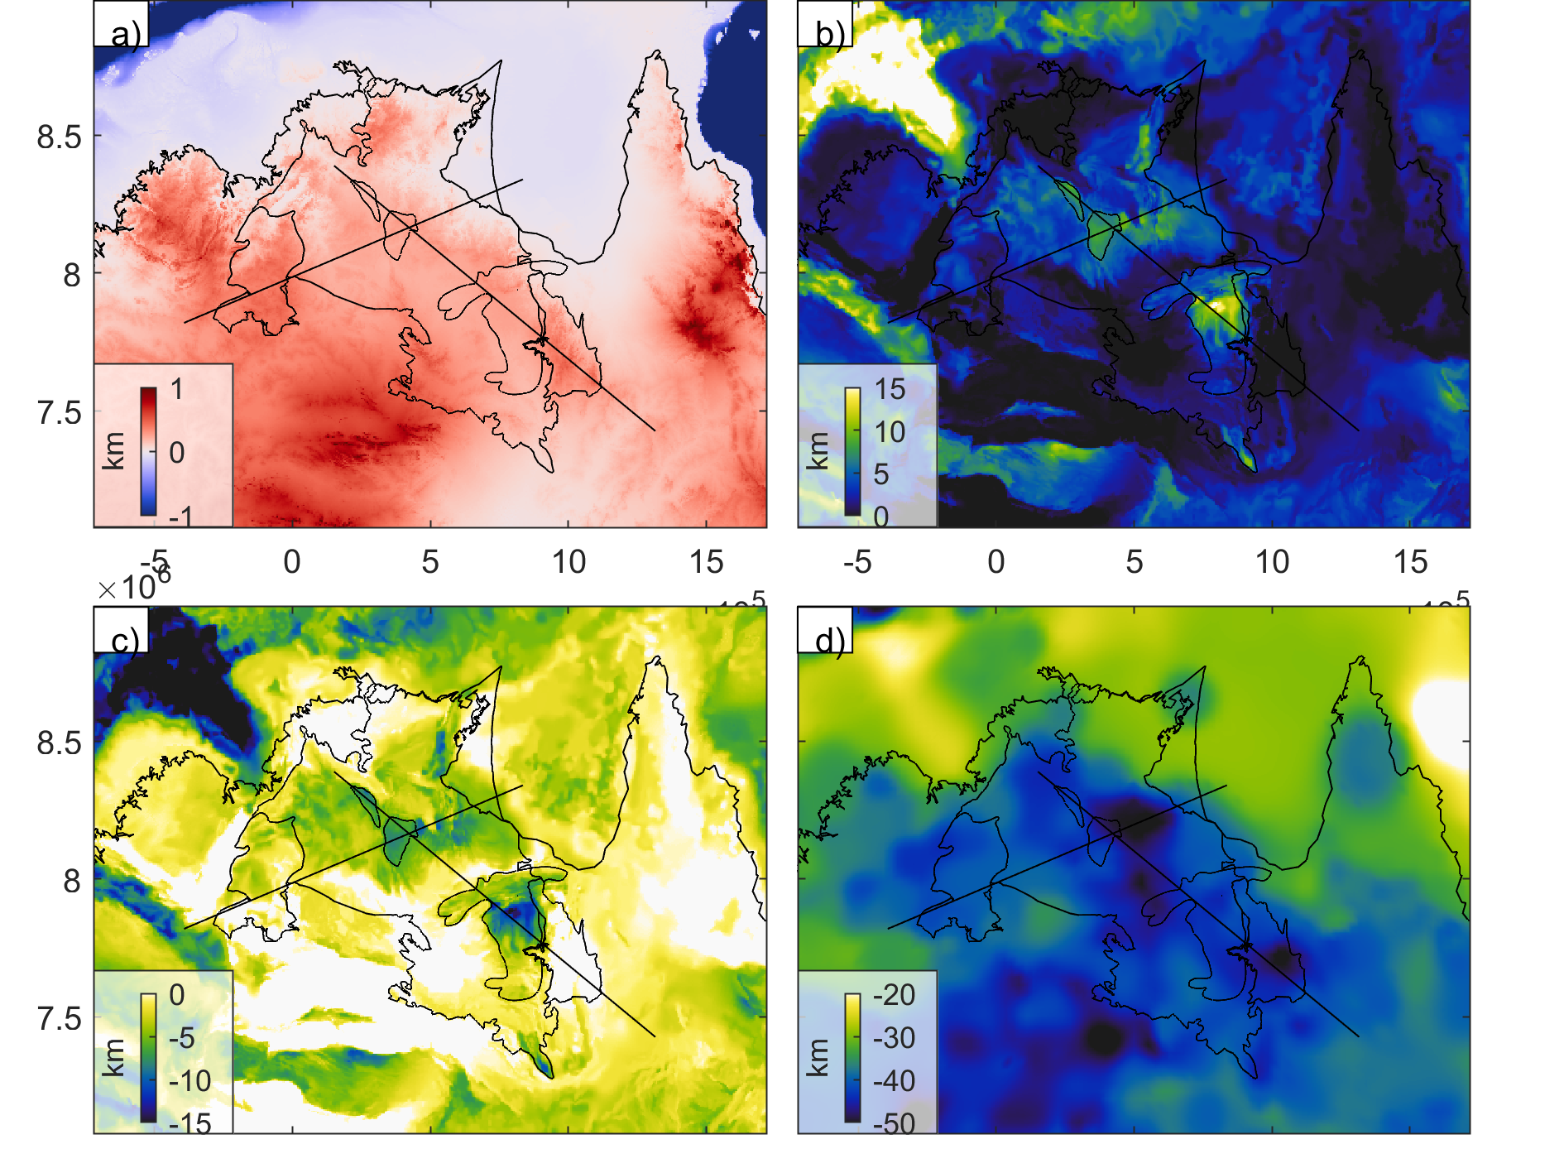
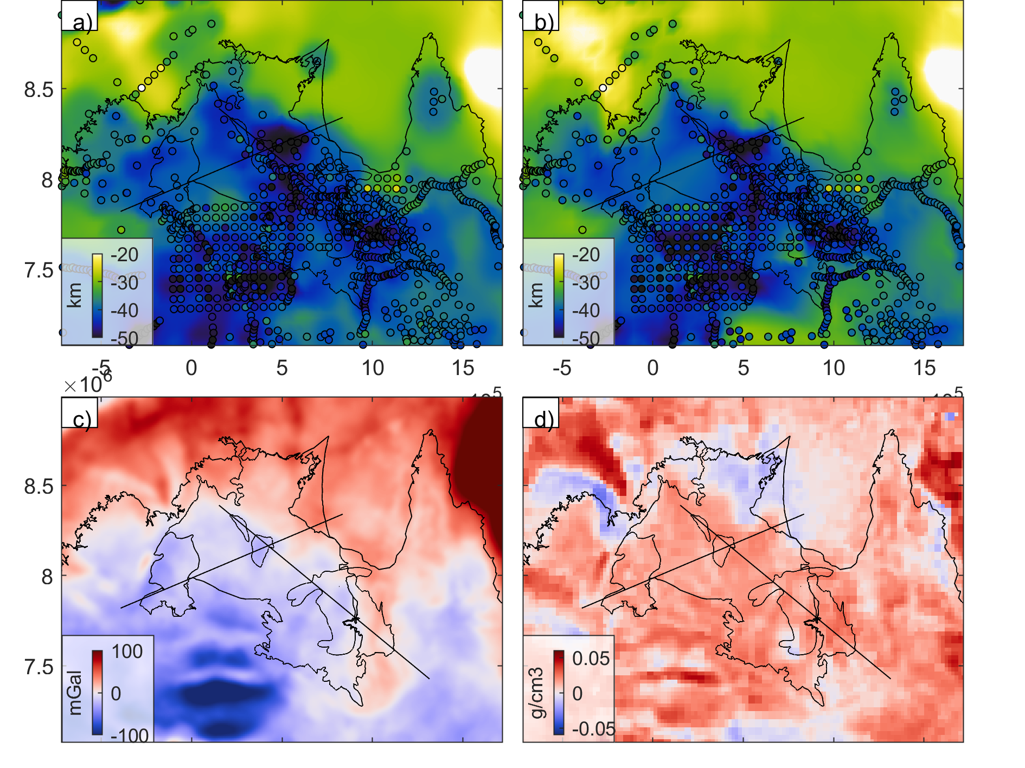
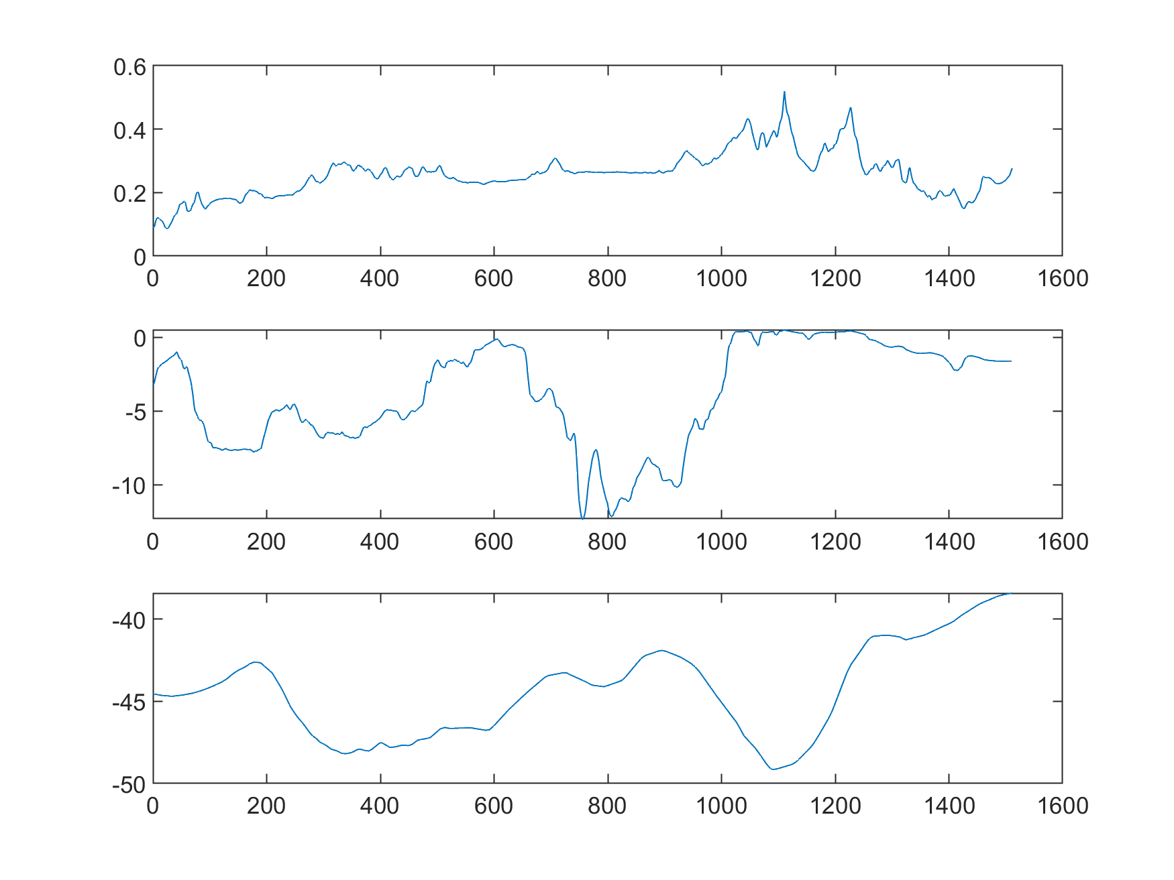
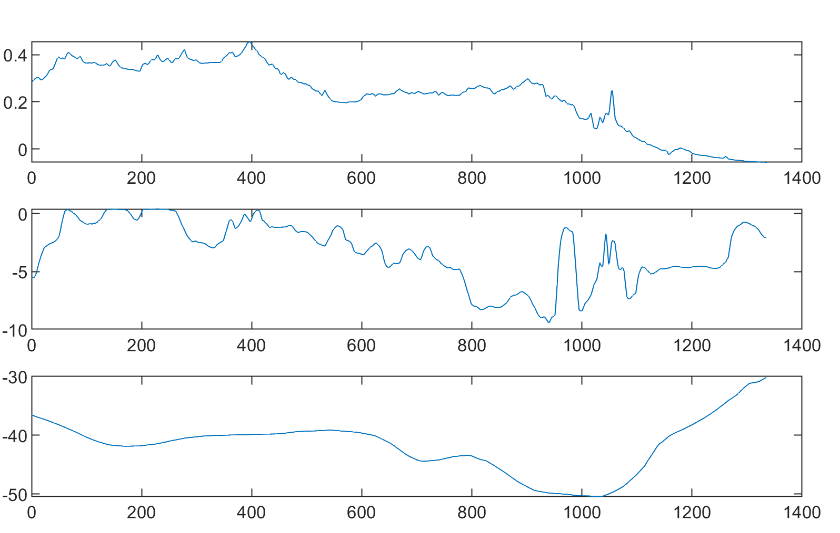
Refined crustal structure and radiogenic heat production in Greater McArthur Basin region by joint inversion of gravity and magnetic data
Lu Li*, Alan Aitken, Weronika Gorczyk, Mark Jessell
lu.li@uwa.edu.au
Centre for Exploration Targeting, University of Western Australia
Get poster and update!
Introduction
Heat generally controls the strength and dynamics of the lithosphere. The Northern Australia Craton, particularly the Greater McArthur Basin area, demonstrates anomalously high surface geothermal heat flow (although the heat flow from the mantle is low). We employ geophysical methods here to constrain the basement geology and radiogenic heat production beneath the Greater McArthur Basin.
Surface Heat Flow with ordinary kriging
Mantle Heat flow
Heat production budeget
See my talk on Thursday! 4:30 – 4:50
BelleVue Ballroom 2
217. Mantle density, temperature, composition, and water content beneath Greater McArthur Basin in North Australian Craton
Conception model
Sedimentary Basin
Upper Crust
Heat production
Radio genetic heat production change
with density (Based on Global dataset, Gard et al., 2019)
Radiogenic
heat production
Lower Crust
Conduction
Moho
Conduction
Lithosphere Mantle
Lithosphere mantle
LAB
Conduction
Asthenosphere
Thermal structure
Current Knowledge about crust structure
Topography
Sediment thickness
Basement
Moho
B
A’
B
A’
B
A’
B
A’
Bir
WBS
EBS
MA
A
A
A
SN
Mt Isa
B’
A
B’
B’
B’
Bouguer Gravity
Data: SEEBASE
Crust Density
B
Kennett et al., 2023
A
A’
B
A’
B
B’
Topography
A’
WBS
EBS
KM
SN
Mt Isa
KM
Bir
EBS
MA
A
A
Basement Surface
B’
B’
Moho
KM
Aitken et al., 2013

Slide 2
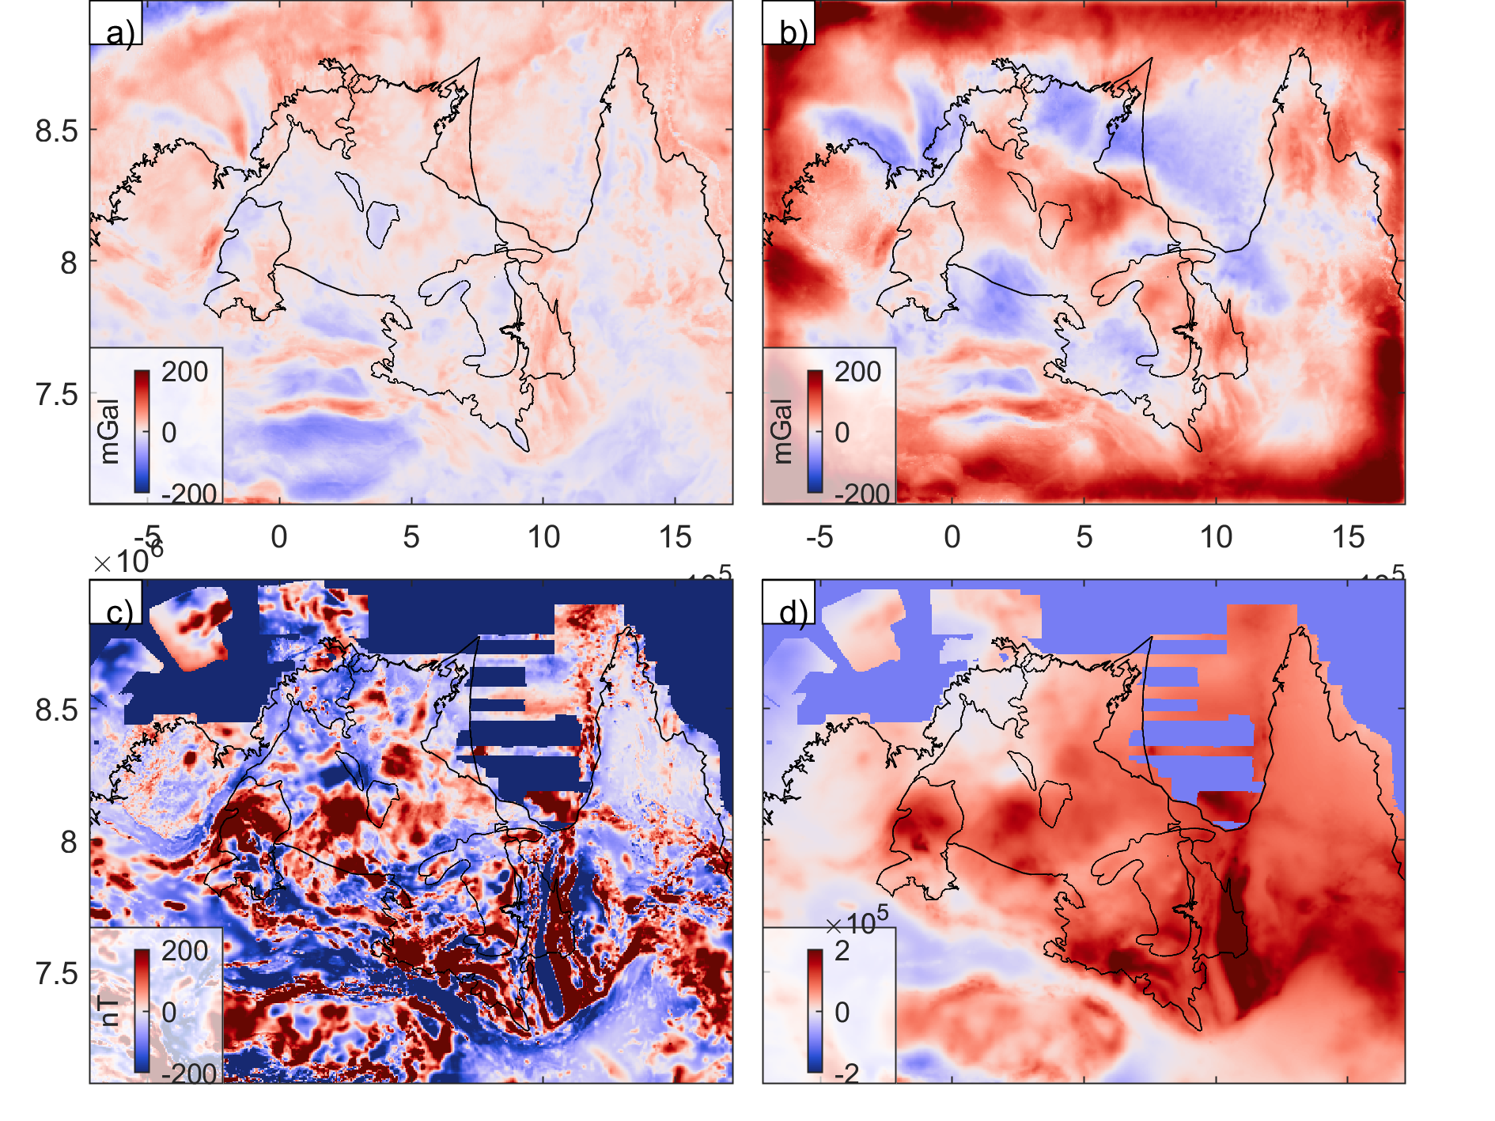

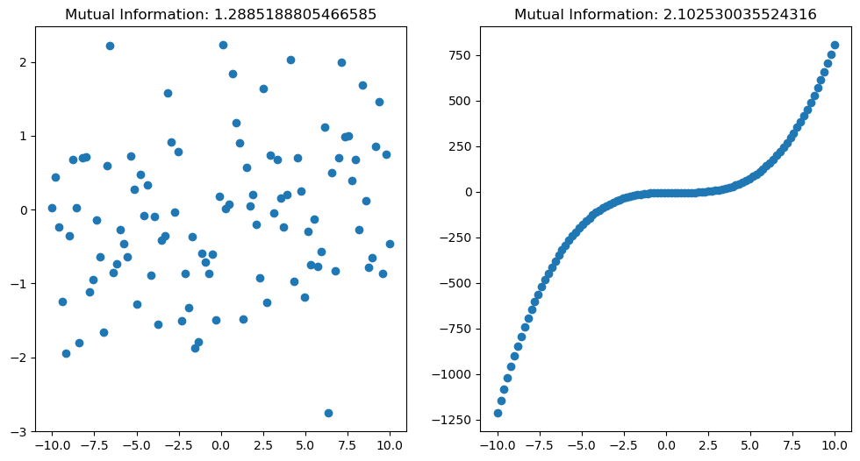
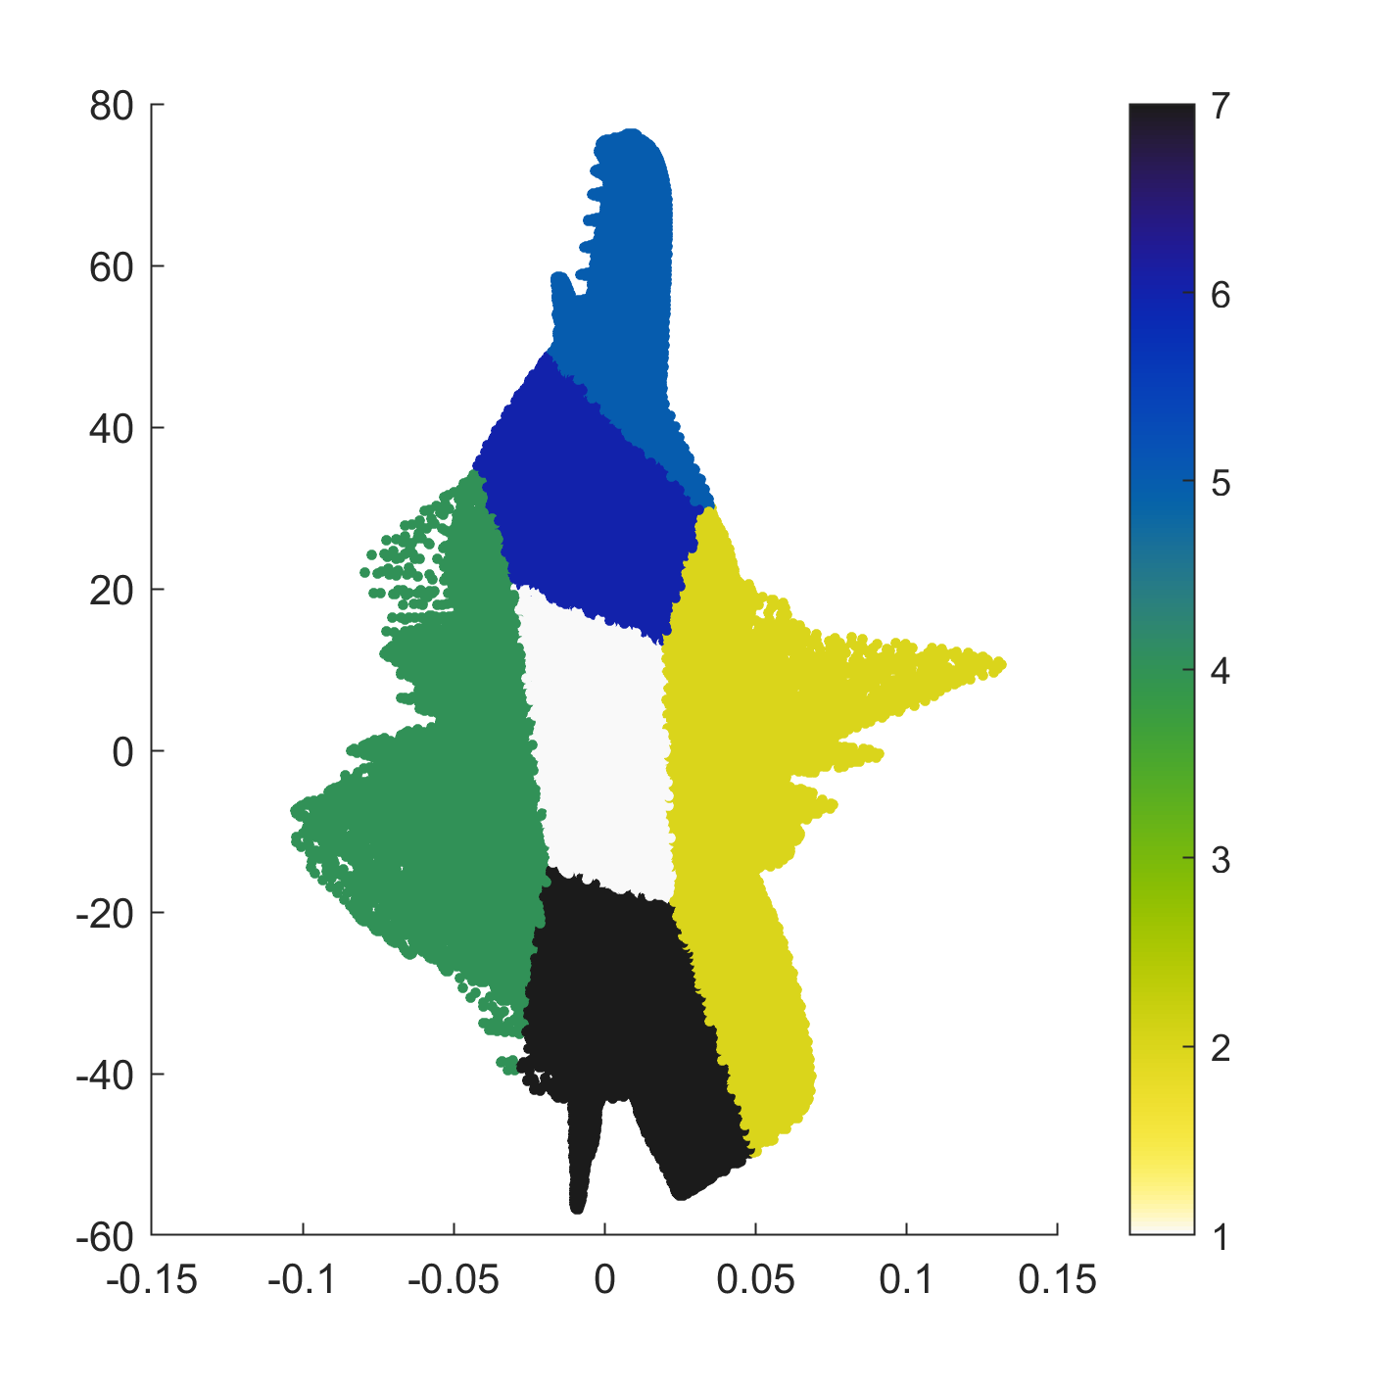
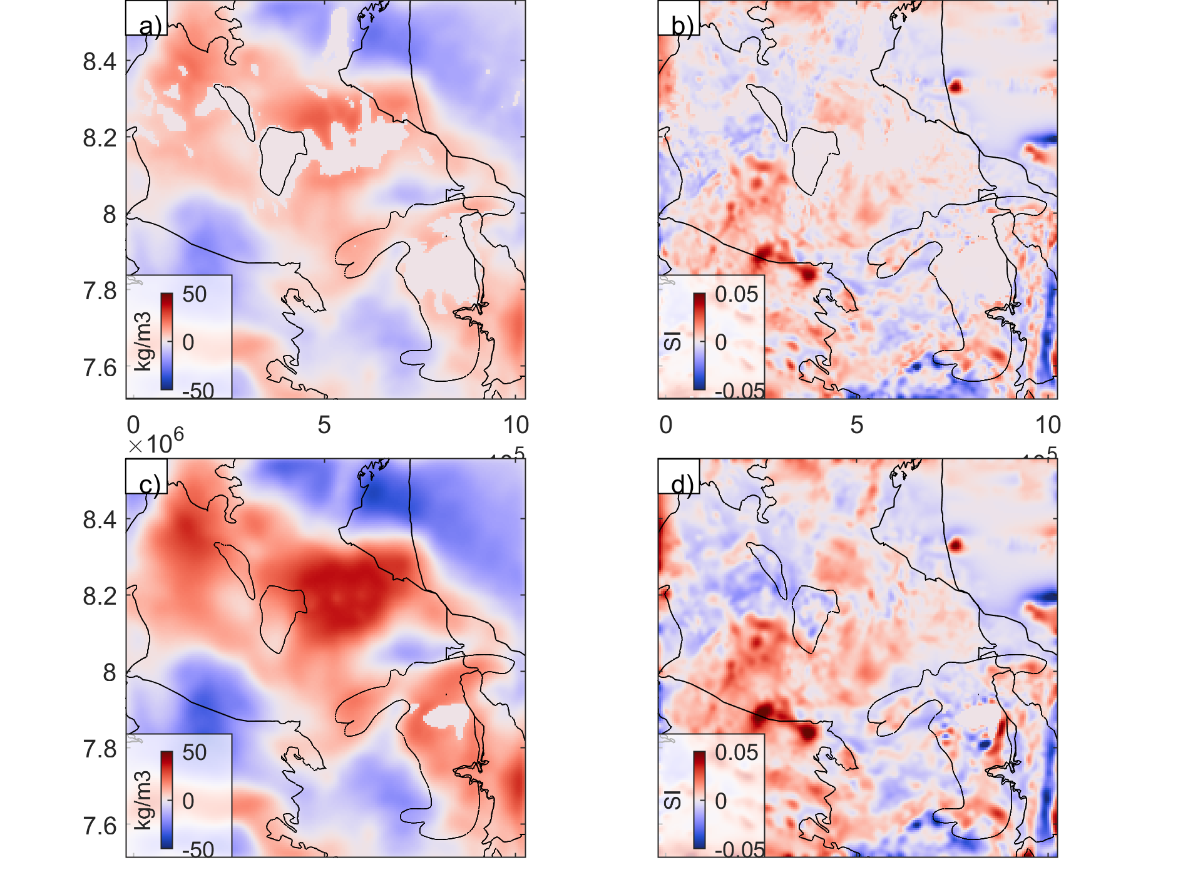
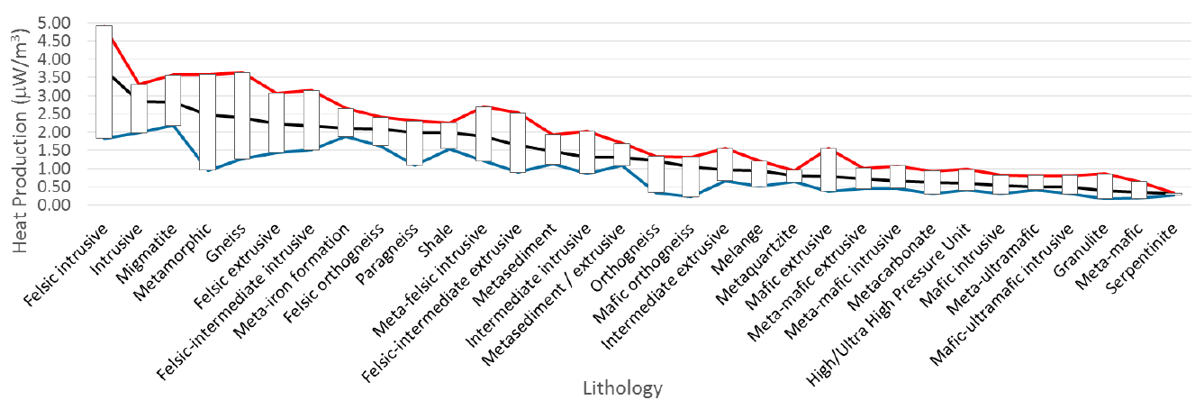
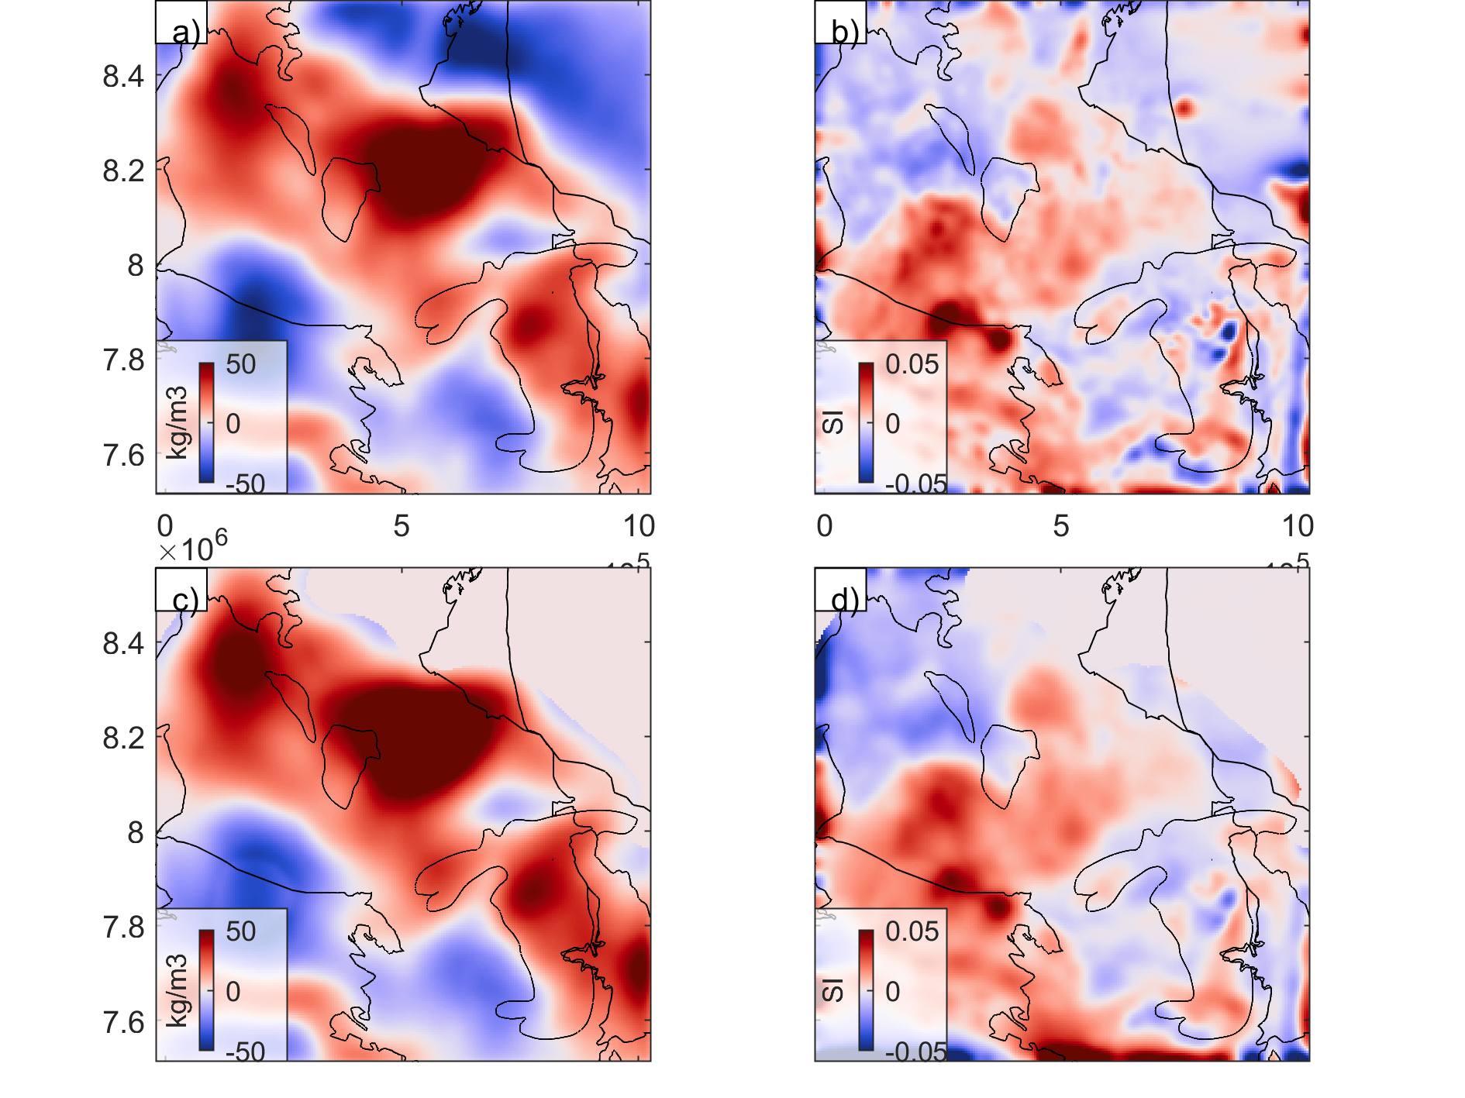
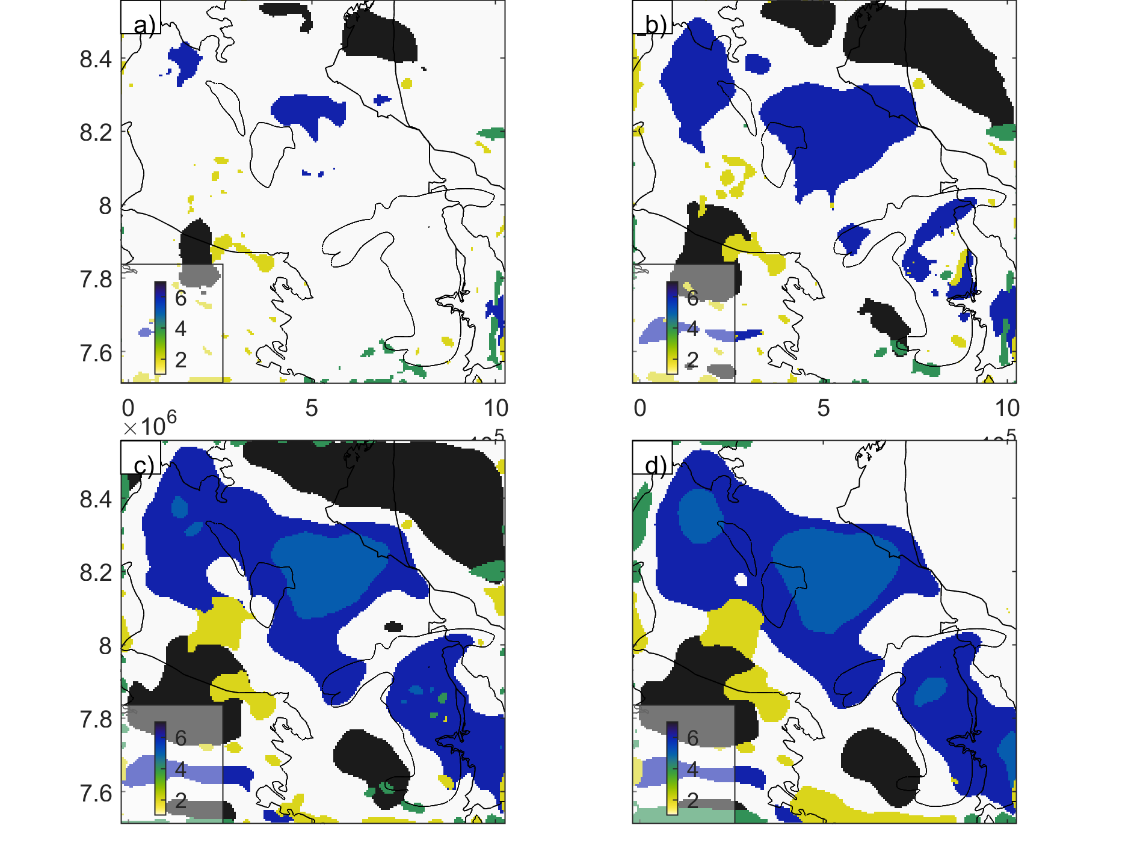
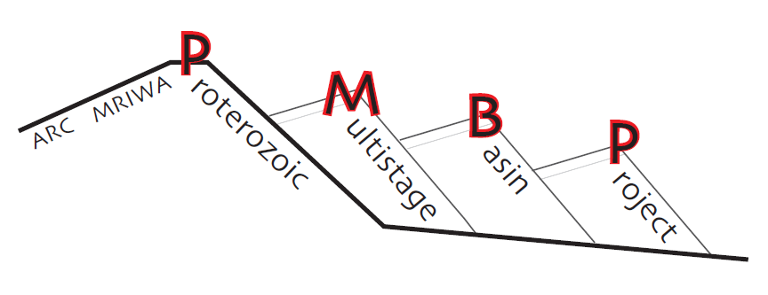


Gravity and Magnetic data
Join inversion with Mutual Information
Isostatic Gravity
Residual Gravity
Use Joint inversion resolve the crust structures from different geophysics measurement using Jif3D.
Inversion framework see Jif3D
(Moorkamp et al., 2011, Lösing et al., 2023).
Mutual Information
TMI-RTP
Pseudo-gravity
Model Result
Here, we cluster the inversion results using the Gaussian Mixture Model into seven clusters. Group 1 indicates a 'background value'. Group 2 represents a Felsic-intermediate intrusive. Group 5 suggests a dense lower crust material, which is likely to be mafic. The basement under the basin is dense, which requires further investigation.
Based on the heat production database, cluster 2 suggest a high radiogenic heat production value, up to 4.5 μW/m³.
Den_5k
Sus_5k
Density
Susceptibility
Den_10k
Sus _10k
Den_20k
Sus _20k
Clustering_5k
Frogtech Geoscience 2018
Clustering_10k
Felsic
Intrusive
Den_35k
Sus _35k
Clustering_20k
Clustering_35k
Mafic
(Underplate?)
Acknowledgement
This project is support by ARC Linkage/MRIWA M554
Evolution of Proterozoic multistage rift basins
The computational resources are supported by the National Computational Infrastructure (NCI).
The following work will integrate the resolved density and susceptibility structures into a 3D geological map, combining information from outcrops and petrophysics. Potential improvements include combining the seismic tomography model and MT model to further constrain the crustal structures.
Reference
Frogtech Geoscience, 2018. SEEBASE® study and GIS for greater McArthur Basin. Northern Territory Geological Survey, Digital Information Package DIP 017.
Lösing, M., Moorkamp, M., & Ebbing, J. (2023). Joint inversion based on variation of information—a crustal model of Wilkes Land, East Antarctica. Geophysical Journal International, 232(1), 162-175.
Aitken, A. R. A., Salmon, M. L., & Kennett, B. L. N. (2013). Australia's Moho: A test of the usefulness of gravity modelling for the determination of Moho depth. Tectonophysics, 609, 468-479.
Moorkamp M., Heincke B., Jegen M., Roberts A.W., Hobbs R.W., 2011. A framework for 3-d joint inversion of mt, gravity and seismic refraction data, J. geophys. Int., 184(1), 477–493. 10.1111/j.1365-246X.2010.04856.x
Gard, M., Hasterok, D., & Halpin, J. A. (2019). Global whole-rock geochemical database compilation. Earth System Science Data, 11(4), 1553-1566.
Kennett, B. L., Gorbatov, A., Yuan, H., Agrawal, S., Murdie, R., Doublier, M. P., ... & Gessner, K. (2023). Refining the Moho across the Australian continent. Geophysical Journal International, 233(3), 1863-1877.

